Slide 1




Expert Guide
-By Team App DeMons’

Slide 2

Team Members :)
Umang Agrawal (Lead) 2018BCS1041
Shruti Gupta 2018BCS1056
Muskan Gupta 2018BCS1175
Shivank Sharma 2018BCS1009
Our Logo
Copyright App Demons’ 2020

Slide 3
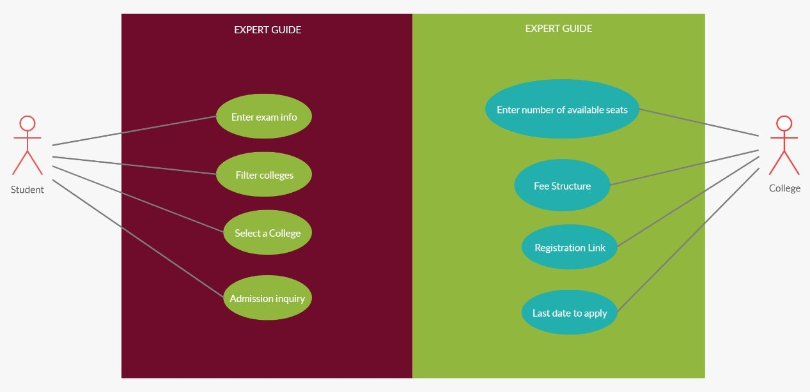
Use Case Diagram

Slide 4
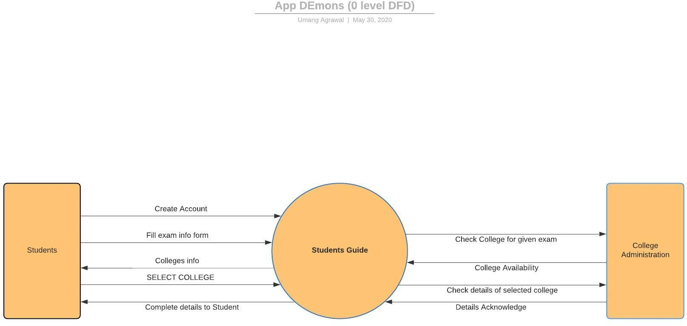
Data Flow Diagram (Level 0)

Slide 5
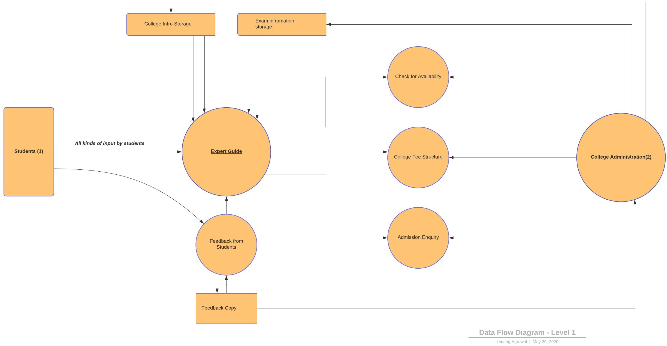
Data Flow Diagram(Level 1)

Slide 6
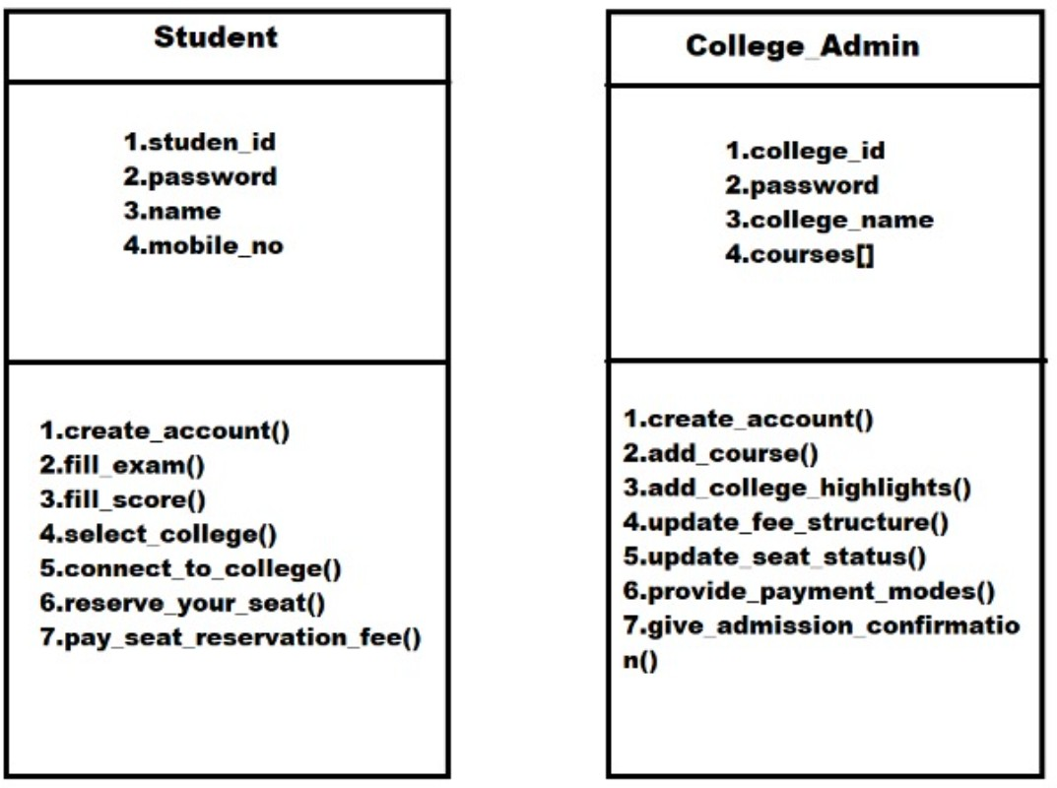
Class Diagram(User1+UserII)

Slide 7
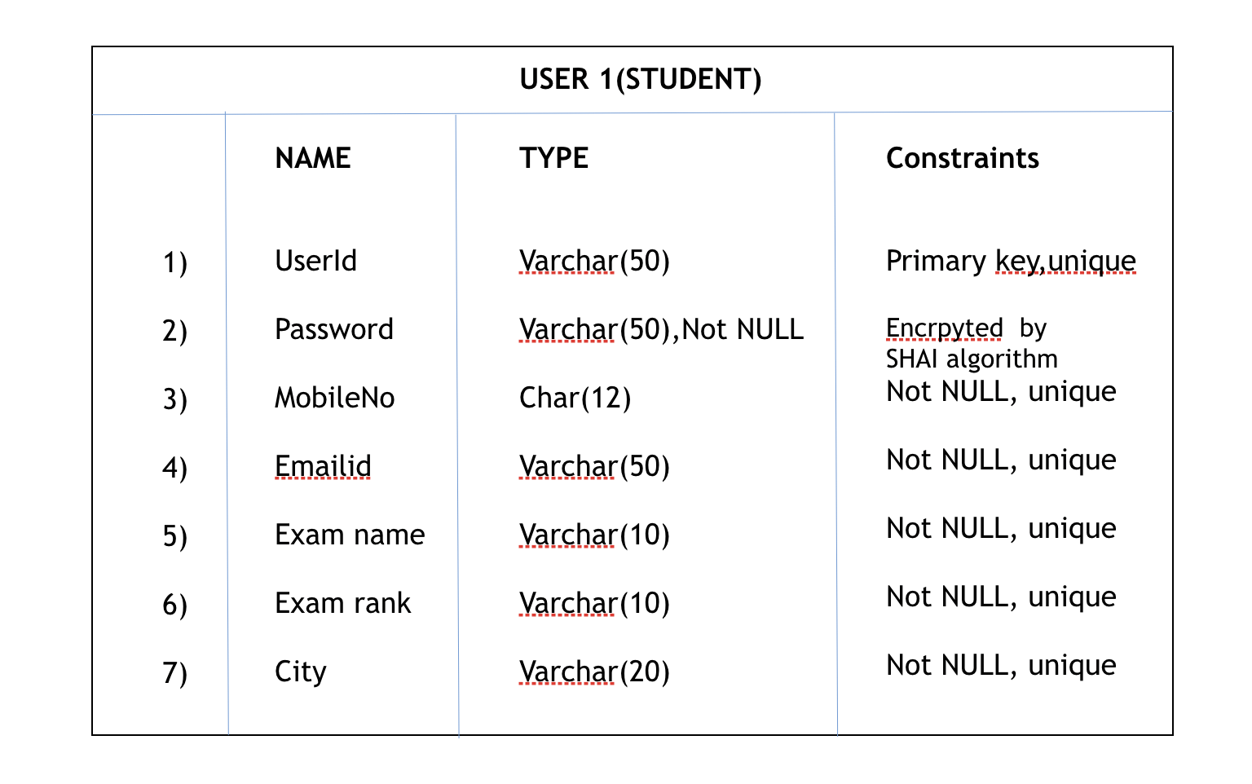
Data Dictionary(User-1)

Slide 8
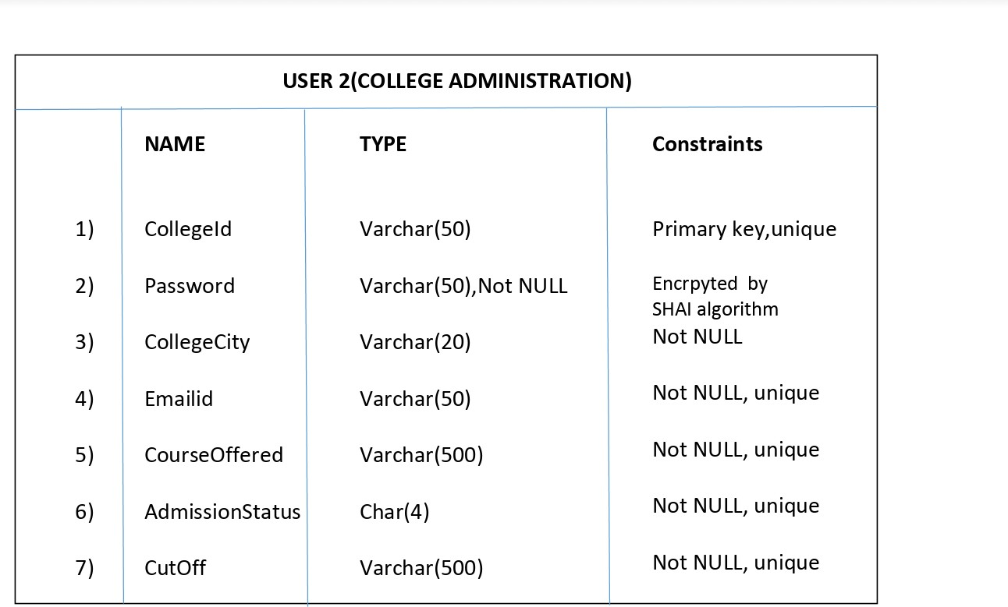
Data Dictionary(User-2)

Slide 9
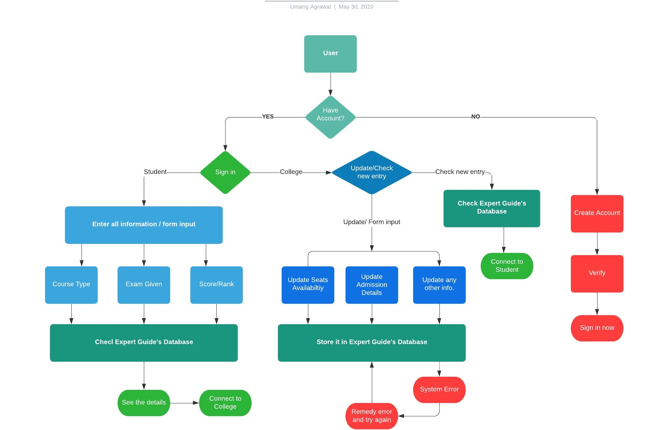
E/R Diagram:

Slide 10

Front Page Demo:

Slide 11
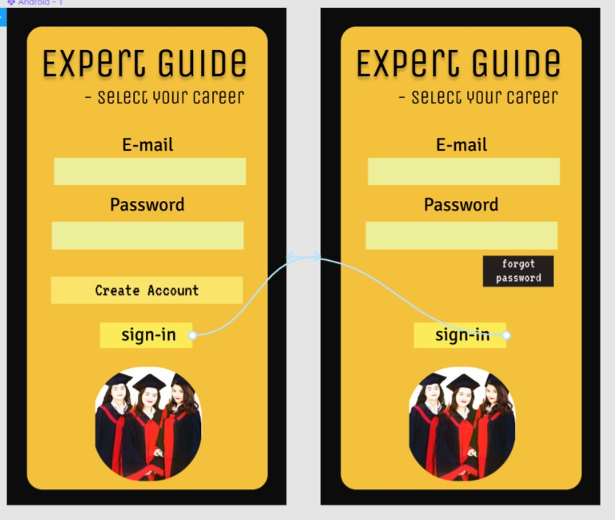
Prototyping (Student)

Slide 12
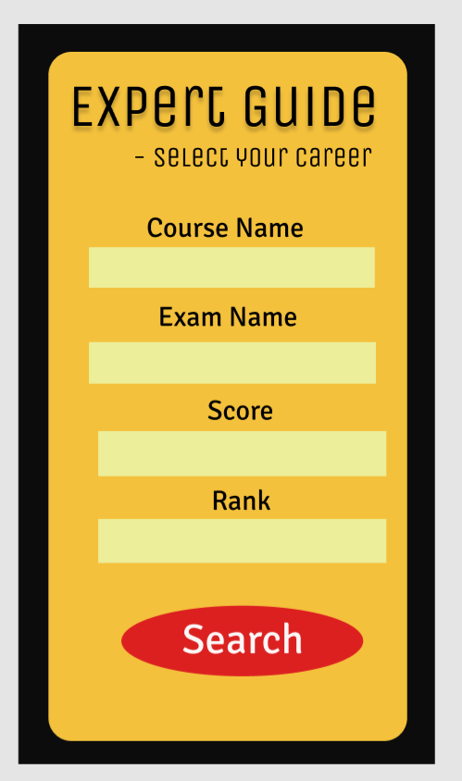
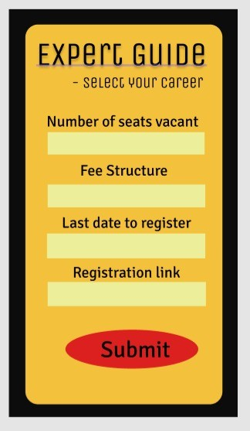
Form Input for Students/College:
Student Form
College Form

Slide 13
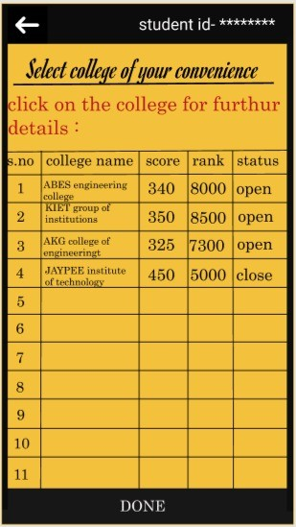
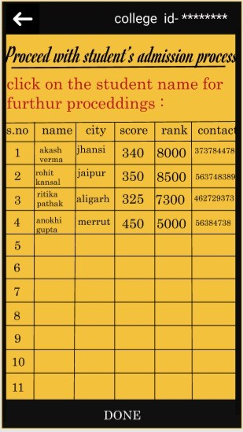

Slide 14

Thank You for your time ;)
Regards :Team App DeMons’

